Slide 1




Evolution of Switches: from Vacuum tubes to MOSFETs

Slide 2

1
Electromagnetic Relays
2
Vacuum Tubes
Topics Covered
3
Bipolar Junction Transistors
4
MOSFETs

Slide 3



Electromagnetic
Relays
Put current through an electromagnet.
Electromagnet pulls a metal armature (kinda like a lever)
The metal armature completes the circuit

Slide 4

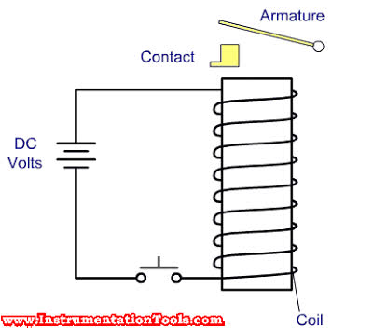

Slide 5

Pretty simple right?
Well, its very useful too. Now your only job is to turn on that electromagnet, which doesn’t take that much effort.
The advantage? You can turn on and off high power circuits using a low power signal.
This means you can (theoretically) use a microcontroller to switch off the power to your entire house, or even a power grid!
(If you manage to sneak in a relay in series with the power wires, that is)

Slide 6




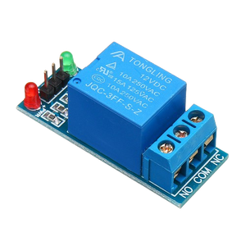
But they are trash
They are the oldest technology, obviously there is a catch.
Slow(er) switching speeds. This is because of the mechanical components
Wear and tear of the mechanical components
If the circuit connected to the armature carries a lot of power, the small gap between the armature and contact might cause arcing across it. No switching off power grids :(
They are large compared to their transistor alternatives
This does not disregard their usefulness though, because they are very useful in several applications to this day.

Slide 7

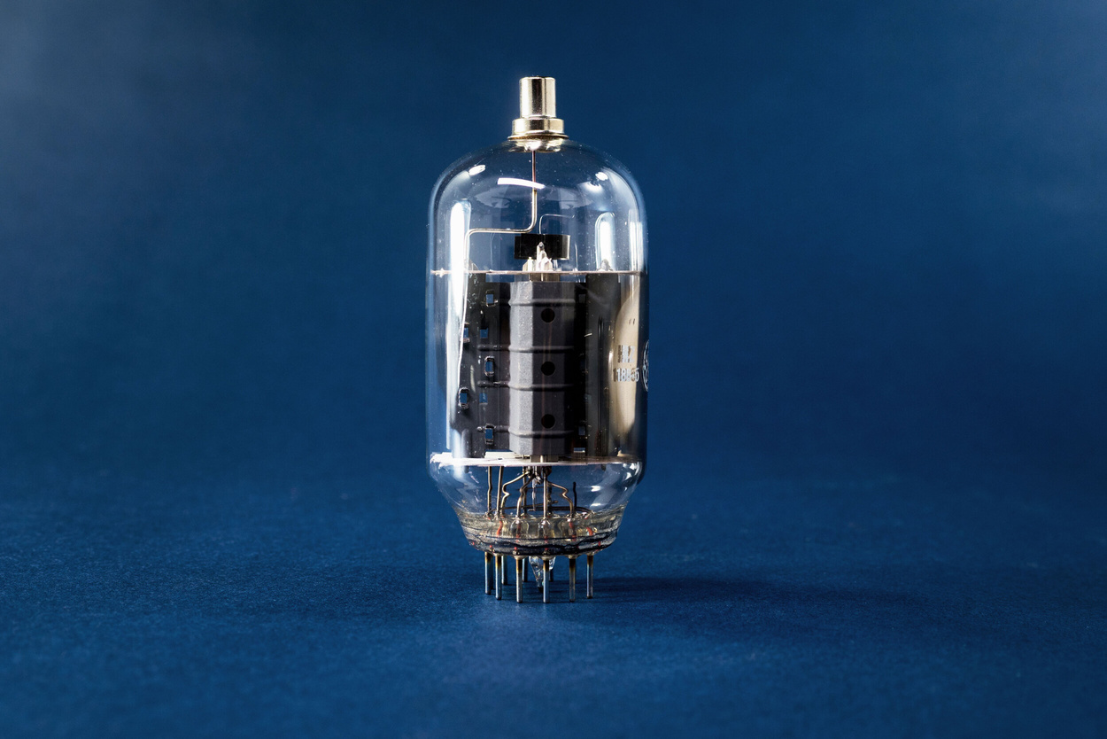
Vacuum Tubes
Remember cathode ray tubes?

Slide 8
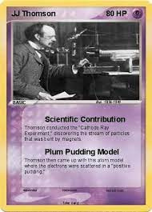
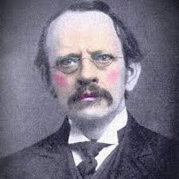
Cathode Ray Tubes
If you apply a large enough potential difference across two plates of a metal, electrons are emitted from the negative terminal to the positive terminal.
Vacuum tubes work using the same principle.

Slide 9
How does it act like a switch?
If the potential difference applied across the metal plates is large enough, the circuit is closed. Otherwise, electrons don’t flow and the circuit is open.
For primitive vacuum tubes, this potential difference was pretty large, making it essentially useless for lower power operations.
However, after some adjustments, it became the primary switching mechanisms for old computers!

Slide 10

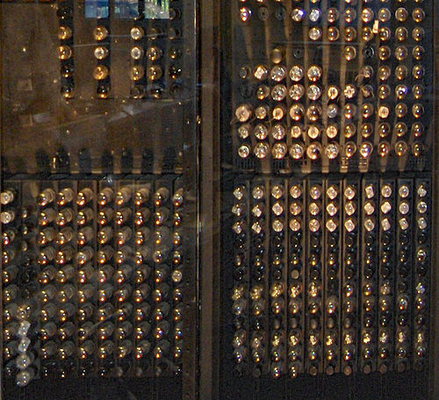
The 1946 ENIAC computer used more than 17,000 vacuum tubes!
Note: Relays were initially used in computers, but were replaced by vacuum tubes because relays were very slow

Slide 11
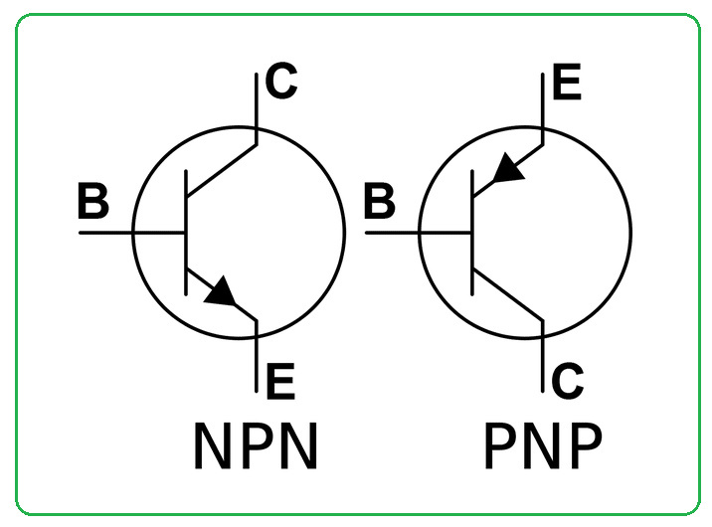
The BJT
Welcome to the transistor era

Slide 12
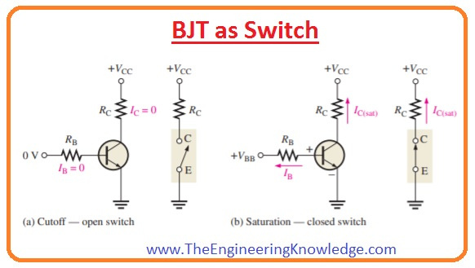

Here’s how the BJT acts as a simple switch.

Slide 13
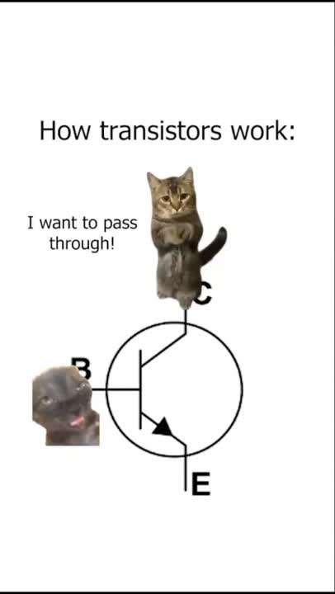
Feel confused?
Let me make it easier for you.

Slide 14
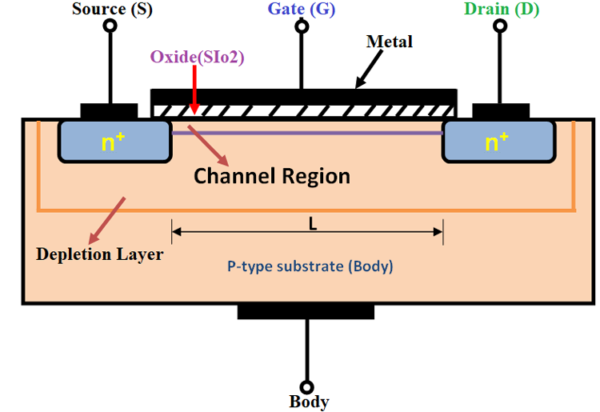
MOSFETs
The reign of Field Effect Transistors
NPN MOSFET Diagram

Slide 15
How is it different from a BJT
The primary difference is that a MOSFET is a potential based device, whereas a BJT is a current based device.
What that means is, while using them as a switch, MOSFETs require a potential at the gate, whereas BJTs require a current at the base to complete the circuit.
MOSFET Technology is usually more superior than BJTs, and are used extensively in digital electronics.

Slide 16
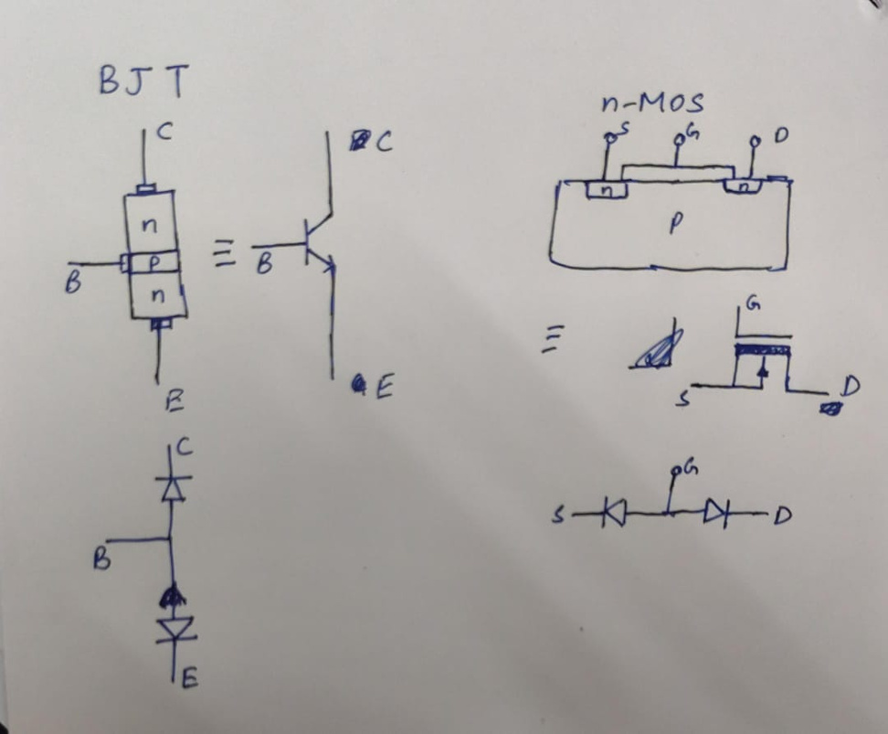
Here’s an intuitive explanation of how transistors work

Slide 17

For more insight

Slide 18

Thank you!
For more information/doubts, feel free to ask the conveners!

